Slide 1
Genome annotation
MDBP-105

Slide 2
Gene annotation
Adding biological information to sequences
There is a gene X in contig Y on location Z
Size of the gene
Name of the gene
Function of the gene (protein / RNA gene)
nifH
nifD
nifK
nifE
nifN
nifB
Contig Y = 20 035 bp

Slide 3
Ways to identify protein coding genes
Sequence alignments
E.g. BLAST
Search contigs against a database
Computationally (and manually) intensive
Gene finding
Start codon (ATG)
Open reading frame (ORF)
Stop codon (TAA, TAG, TGA)

Slide 4
Functions to genes
Homology
Statictical modelling of protein families/domains
Annotation databases
NCBI
KEGG
COG
SEED
GO
UNIPROT
INTERPRO
PFAM
TIGR
…

Slide 5
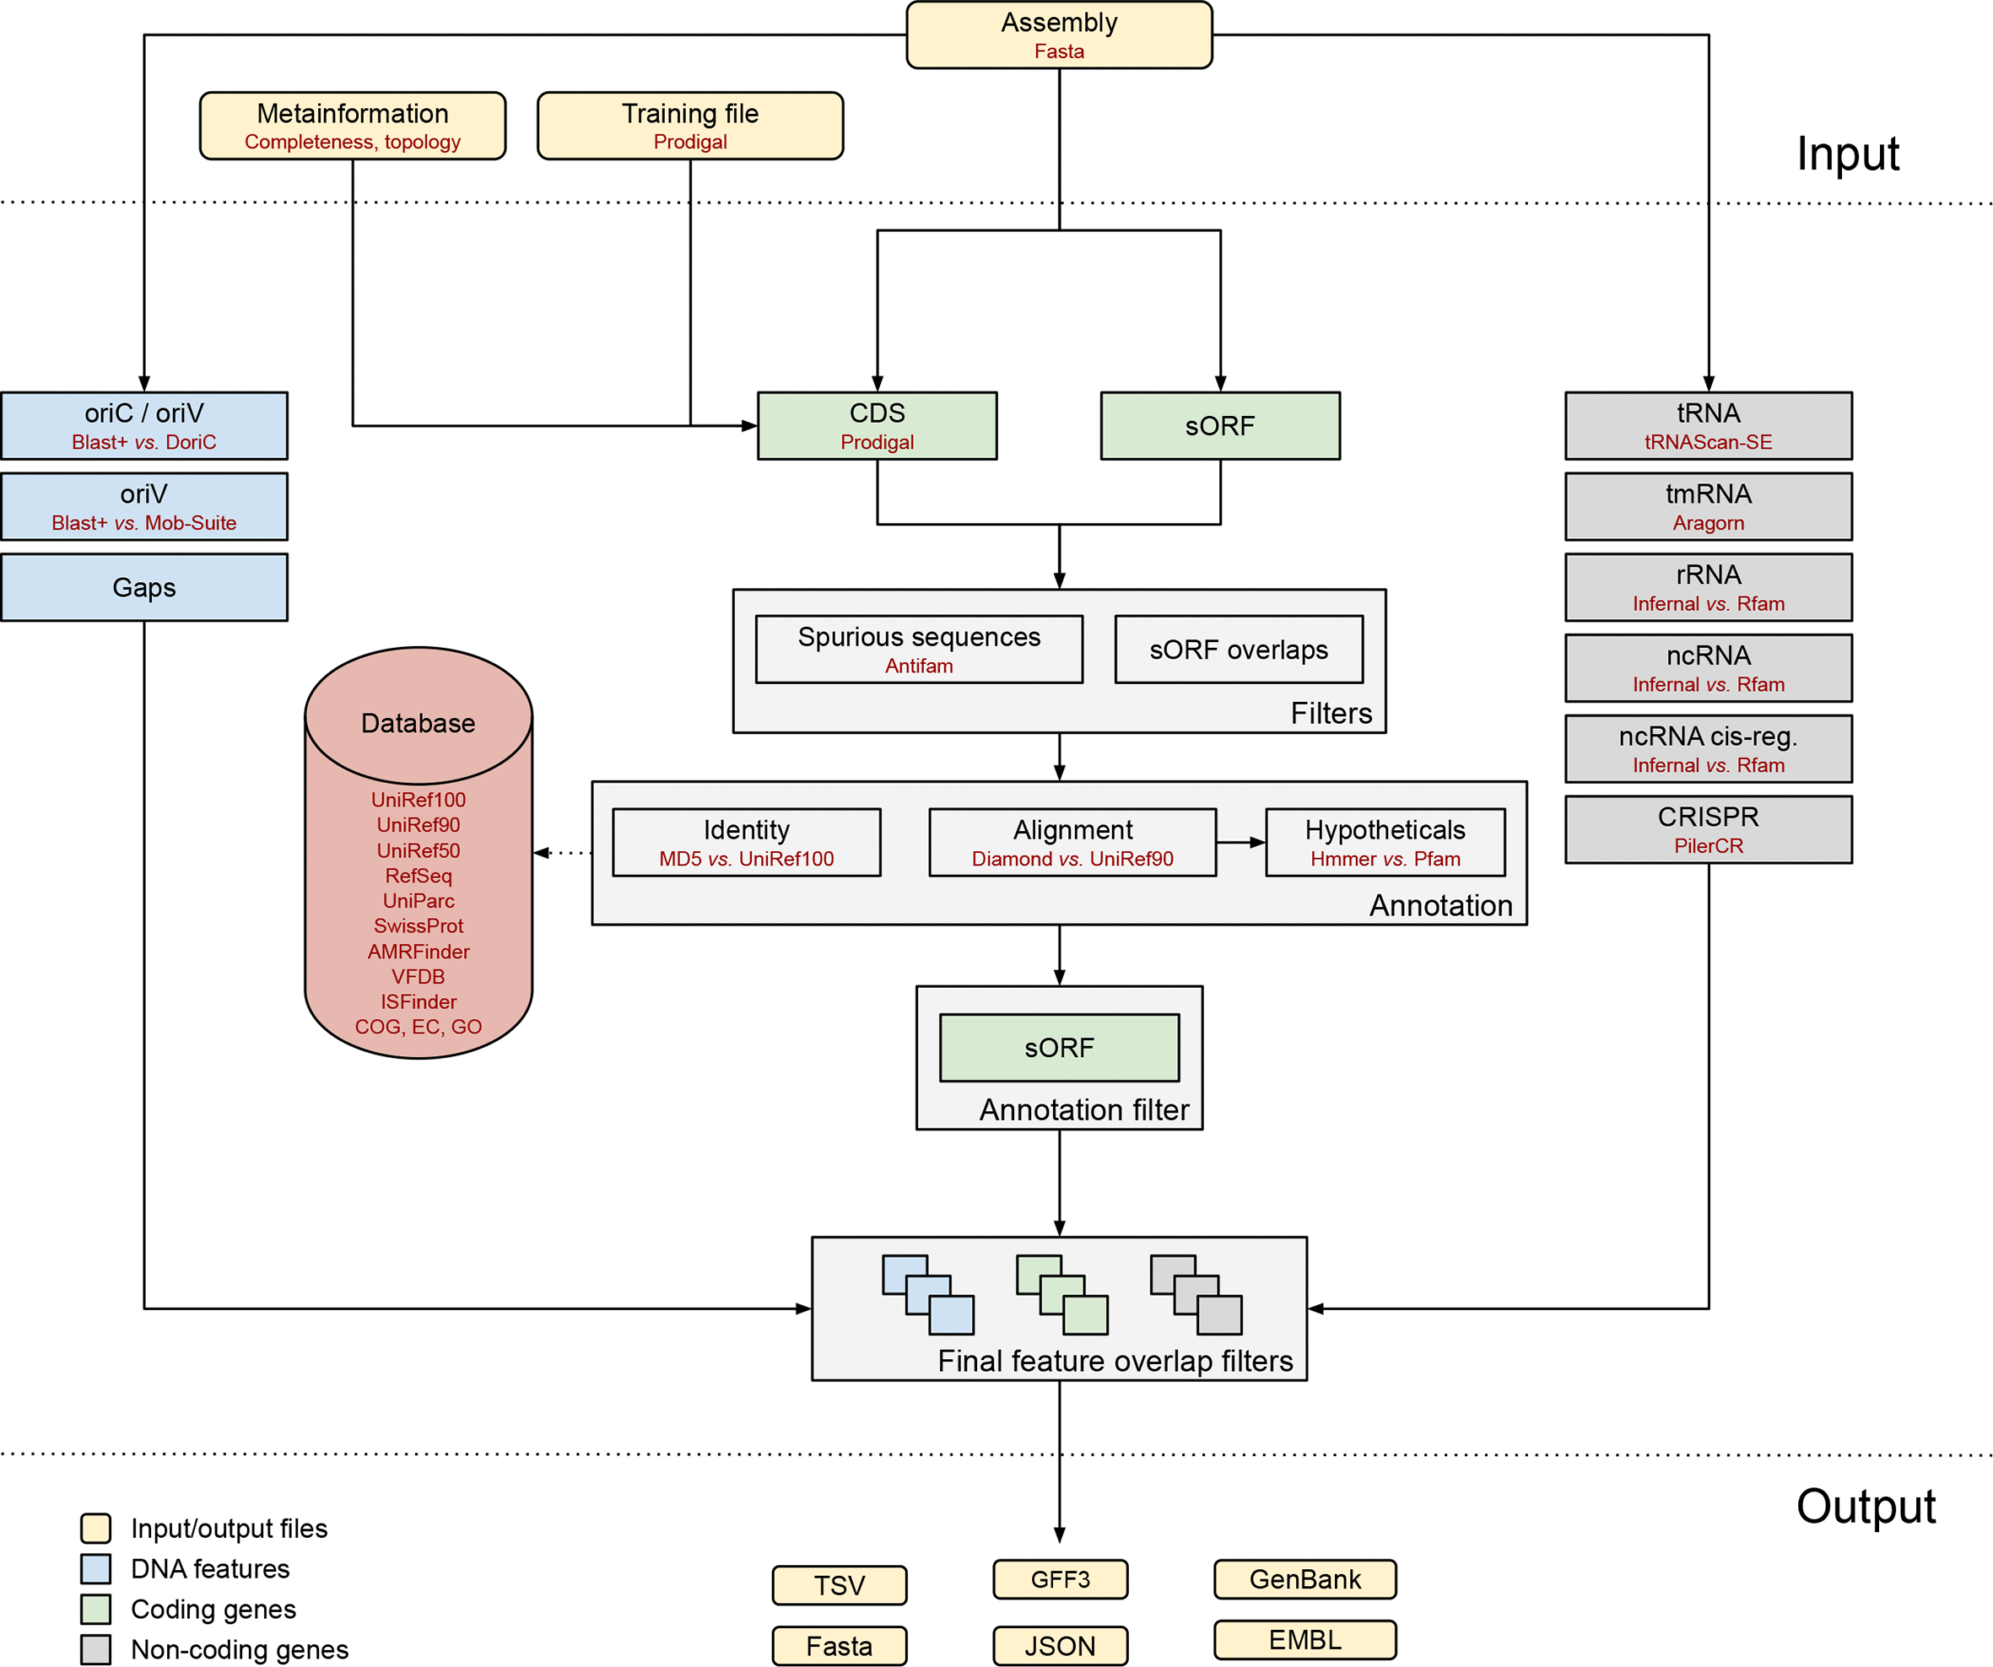
BAKTA
rapid and standardized annotation of bacterial genomes via alignment-free sequence identification
https://doi.org/10.1099/mgen.0.000685

Slide 6
Taxonomy and completeness of your genome
CheckM2
GTDB-Tk
Predicts genome completeness and contamination based on ML model
Designed for metagenome-assembled genomes (MAGs)
The Genome Taxonomy Database Toolkit
Taxonomic assignment based on GTDB
Domain-specific concatenated protein reference trees

